Slide 1
CS 300- Memory Management

Slide 2
Background
Program must be brought (from disk) into memory and placed within a process for it to be run
Main memory and registers are only storage CPU can access directly
Memory unit only sees a stream of addresses + read requests, or address + data and write requests
Register access in one CPU clock (or less)
Main memory can take many cycles, causing a stall
Cache sits between main memory and CPU registers
Protection of memory required to ensure correct operation

Slide 3
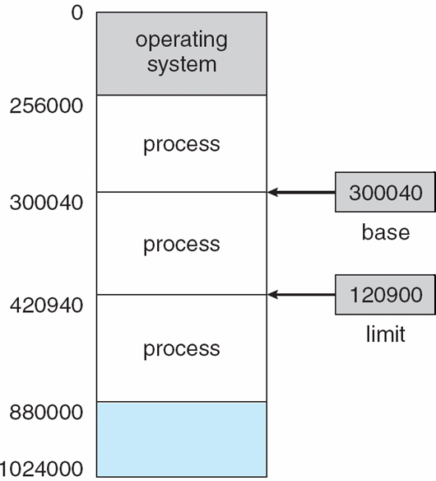
Base and Limit Registers
A pair of base and limit registers define the logical address space
CPU must check every memory access generated in user mode to be sure it is between base and limit for that user

Slide 4
Hardware Address Protection

Slide 5
Address Binding
Programs on disk, ready to be brought into memory to execute form an input queue
Without support, must be loaded into address 0000
Inconvenient to have first user process physical address always at 0000
Further, addresses represented in different ways at different stages of a program’s life
Source code addresses usually symbolic
Compiled code addresses bind to relocatable addresses
i.e. “14 bytes from beginning of this module”
Linker or loader will bind relocatable addresses to absolute addresses
i.e. 74014
Each binding maps one address space to another

Slide 6
Binding of Instructions and Data to Memory
Address binding of instructions and data to memory addresses can happen at three different stages
Compile time: If memory location known a priori, absolute code can be generated; must recompile code if starting location changes
Load time: Must generate relocatable code if memory location is not known at compile time
Execution time: Binding delayed until run time if the process can be moved during its execution from one memory segment to another
Need hardware support for address maps (e.g., base and limit registers)

Slide 7
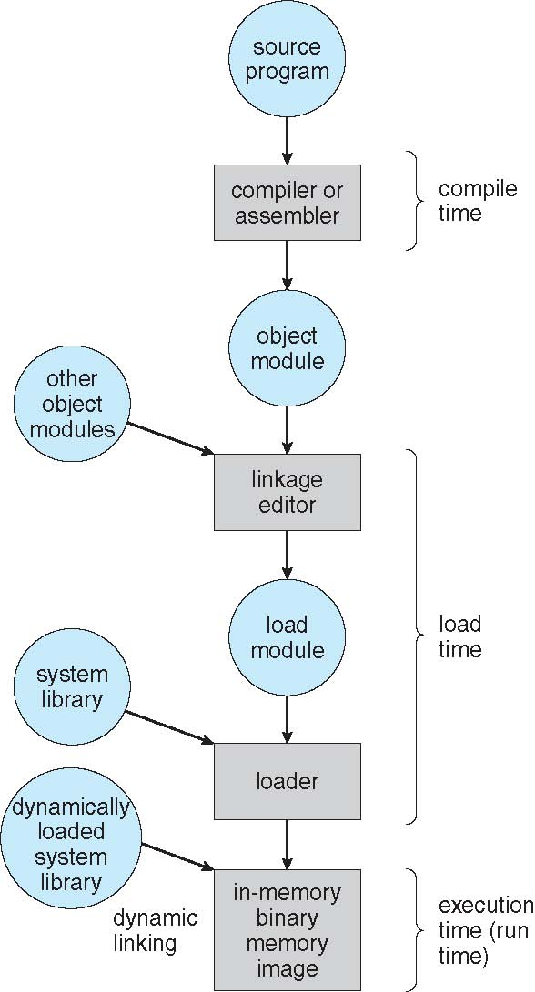
Multistep Processing of a User Program

Slide 8
Logical vs. Physical Address Space
The concept of a logical address space that is bound to a separate physical address space is central to proper memory management
Logical address – generated by the CPU; also referred to as virtual address
Physical address – address seen by the memory unit
Logical and physical addresses are the same in compile-time and load-time address-binding schemes; logical (virtual) and physical addresses differ in execution-time address-binding scheme
Logical address space is the set of all logical addresses generated by a program
Physical address space is the set of all physical addresses generated by a program

Slide 9
Memory-Management Unit (MMU)
Hardware device that at run time maps virtual to physical address
Many methods possible
To start, consider simple scheme where the value in the relocation register is added to every address generated by a user process at the time it is sent to memory
Base register now called relocation register
MS-DOS on Intel 80x86 used 4 relocation registers
The user program deals with logical addresses; it never sees the real physical addresses
Execution-time binding occurs when reference is made to location in memory
Logical address bound to physical addresses

Slide 10
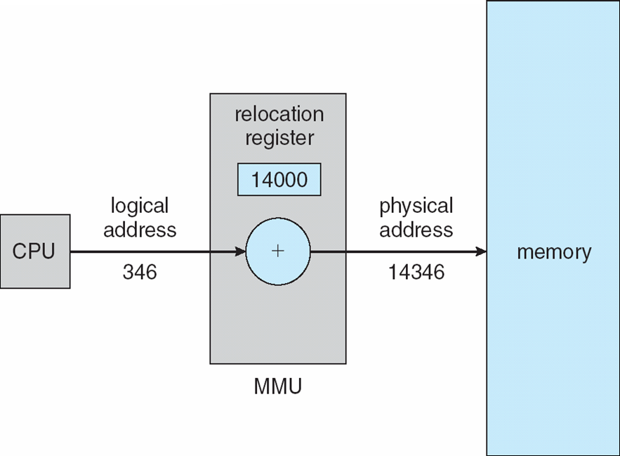
Dynamic relocation using a relocation register
Routine is not loaded until it is called
Better memory-space utilization; unused routine is never loaded
All routines kept on disk in relocatable load format
Useful when large amounts of code are needed to handle infrequently occurring cases
No special support from the operating system is required
Implemented through program design
OS can help by providing libraries to implement dynamic loading

Slide 11
Dynamic Linking
Static linking – system libraries and program code combined by the loader into the binary program image
Dynamic linking –linking postponed until execution time
Small piece of code, stub, used to locate the appropriate memory-resident library routine
Stub replaces itself with the address of the routine, and executes the routine
Operating system checks if routine is in processes’ memory address
If not in address space, add to address space
Dynamic linking is particularly useful for libraries
System also known as shared libraries
Consider applicability to patching system libraries
Versioning may be needed

Slide 12
Swapping
A process can be swapped temporarily out of memory to a backing store, and then brought back into memory for continued execution
Total physical memory space of processes can exceed physical memory
Backing store – fast disk large enough to accommodate copies of all memory images for all users; must provide direct access to these memory images
Roll out, roll in – swapping variant used for priority-based scheduling algorithms; lower-priority process is swapped out so higher-priority process can be loaded and executed
Major part of swap time is transfer time; total transfer time is directly proportional to the amount of memory swapped
System maintains a ready queue of ready-to-run processes which have memory images on disk

Slide 13
Swapping (Cont.)
Does the swapped out process need to swap back in to same physical addresses?
Depends on address binding method
Plus consider pending I/O to / from process memory space
Modified versions of swapping are found on many systems (i.e., UNIX, Linux, and Windows)
Swapping normally disabled
Started if more than threshold amount of memory allocated
Disabled again once memory demand reduced below threshold

Slide 14
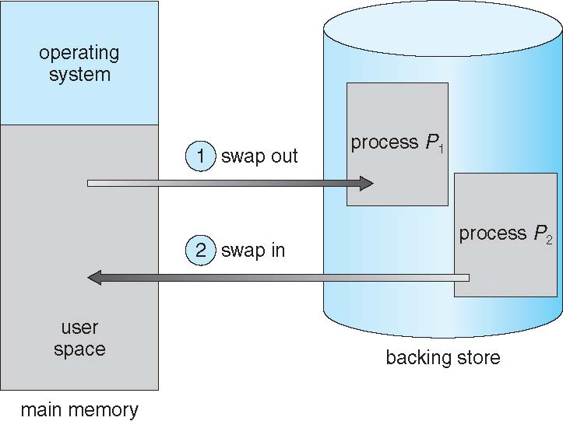
Schematic View of Swapping

Slide 15
Context Switch Time including Swapping
If next processes to be put on CPU is not in memory, need to swap out a process and swap in target process
Context switch time can then be very high
100MB process swapping to hard disk with transfer rate of 50MB/sec
Swap out time of 2000 ms
Plus swap in of same sized process
Total context switch swapping component time of 4000ms (4 seconds)
Can reduce if reduce size of memory swapped – by knowing how much memory really being used
System calls to inform OS of memory use via request_memory() and release_memory()

Slide 16
Context Switch Time and Swapping (Cont.)
Other constraints as well on swapping
Pending I/O – can’t swap out as I/O would occur to wrong process
Or always transfer I/O to kernel space, then to I/O device
Known as double buffering, adds overhead
Standard swapping not used in modern operating systems
But modified version common
Swap only when free memory extremely low

Slide 17
Contiguous Allocation
Main memory must support both OS and user processes
Limited resource, must allocate efficiently
Contiguous allocation is one early method
Main memory usually into two partitions:
Resident operating system, usually held in low memory with interrupt vector
User processes then held in high memory
Each process contained in single contiguous section of memory

Slide 18
Contiguous Allocation (Cont.)
Relocation registers used to protect user processes from each other, and from changing operating-system code and data
Base register contains value of smallest physical address
Limit register contains range of logical addresses – each logical address must be less than the limit register
MMU maps logical address dynamically
Can then allow actions such as kernel code being transient and kernel changing size

Slide 19
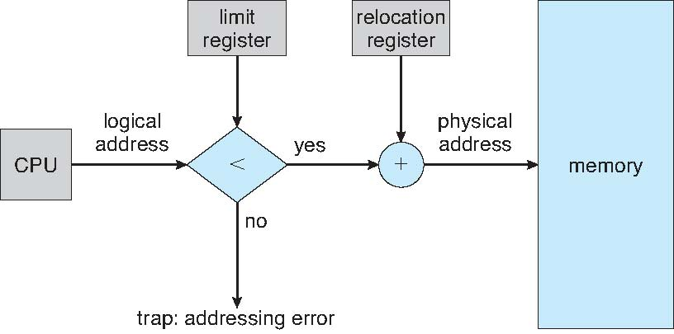
Hardware Support for Relocation and Limit Registers

Slide 20
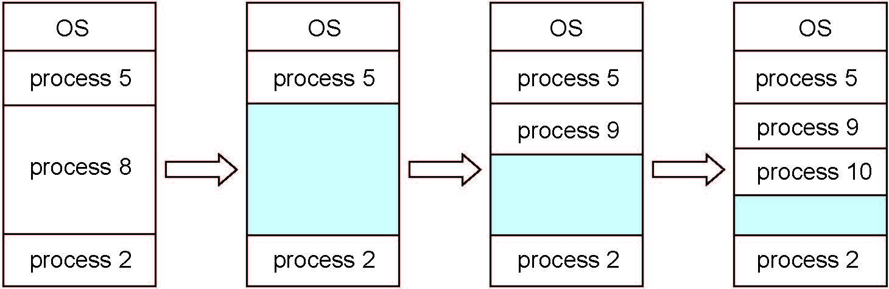
Multiple-partition allocation
Multiple-partition allocation
Degree of multiprogramming limited by number of partitions
Variable-partition sizes for efficiency (sized to a given process’ needs)
Hole – block of available memory; holes of various size are scattered throughout memory
When a process arrives, it is allocated memory from a hole large enough to accommodate it
Process exiting frees its partition, adjacent free partitions combined
Operating system maintains information about: a) allocated partitions b) free partitions (hole)

Slide 21
Dynamic Storage-Allocation Problem
How to satisfy a request of size n from a list of free holes?
First-fit: Allocate the first hole that is big enough
Best-fit: Allocate the smallest hole that is big enough; must search entire list, unless ordered by size
Produces the smallest leftover hole
Worst-fit: Allocate the largest hole; must also search entire list
Produces the largest leftover hole
First-fit and best-fit better than worst-fit in terms of speed and storage utilization

Slide 22
Fragmentation
External Fragmentation – total memory space exists to satisfy a request, but it is not contiguous
Internal Fragmentation – allocated memory may be slightly larger than requested memory; this size difference is memory internal to a partition, but not being used
First fit analysis reveals that given N blocks allocated, 0.5 N blocks lost to fragmentation
1/3 may be unusable -> 50-percent rule

Slide 23
Fragmentation (Cont.)
Reduce external fragmentation by compaction
Shuffle memory contents to place all free memory together in one large block
Compaction is possible only if relocation is dynamic, and is done at execution time
I/O problem
Latch job in memory while it is involved in I/O
Do I/O only into OS buffers
Now consider that backing store has same fragmentation problems

Slide 24
Segmentation
Memory-management scheme that supports user view of memory
A program is a collection of segments
A segment is a logical unit such as:
main program
procedure
function
method
object
local variables, global variables
common block
stack
symbol table
arrays

Slide 25
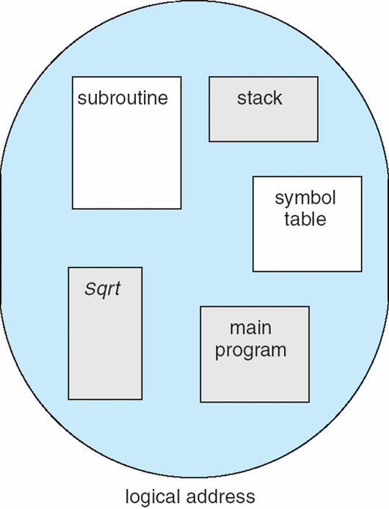
User’s View of a Program

Slide 26
Logical View of Segmentation
1
1
4
2
3
4
2
3
user space
physical memory space

Slide 27
Segmentation Architecture
Logical address consists of a two tuple:
<segment-number, offset>,
Segment table – maps two-dimensional physical addresses; each table entry has:
base – contains the starting physical address where the segments reside in memory
limit – specifies the length of the segment
Segment-table base register (STBR) points to the segment table’s location in memory
Segment-table length register (STLR) indicates number of segments used by a program;
segment number s is legal if s < STLR

Slide 28
Segmentation Architecture (Cont.)
Protection
With each entry in segment table associate:
validation bit = 0 ⇒ illegal segment
read/write/execute privileges
Protection bits associated with segments; code sharing occurs at segment level
Since segments vary in length, memory allocation is a dynamic storage-allocation problem

Slide 29
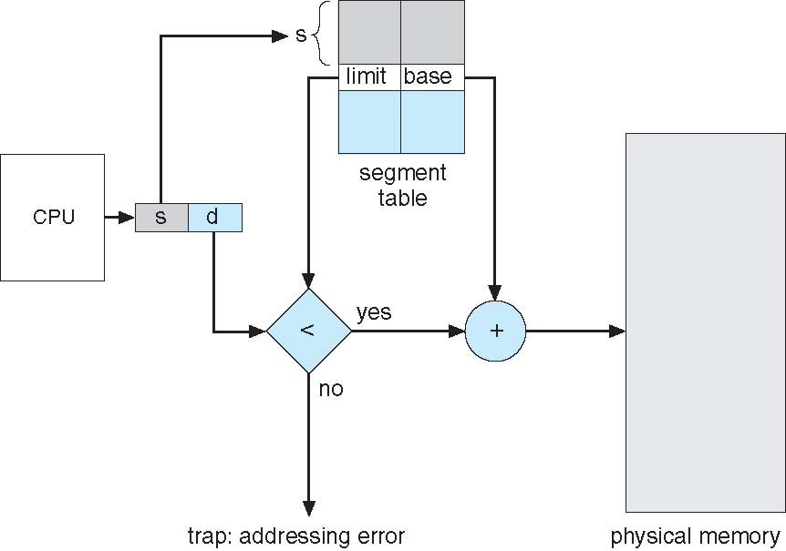
Segmentation Hardware

Slide 30
Paging
Physical address space of a process can be noncontiguous; process is allocated physical memory whenever the latter is available
Avoids external fragmentation
Avoids problem of varying sized memory chunks
Divide physical memory into fixed-sized blocks called frames
Size is power of 2, between 512 bytes and 16 Mbytes
Divide logical memory into blocks of same size called pages
Keep track of all free frames
To run a program of size N pages, need to find N free frames and load program
Set up a page table to translate logical to physical addresses
Backing store likewise split into pages
Still have Internal fragmentation

Slide 31
Address Translation Scheme
Address generated by CPU is divided into:
Page number (p) – used as an index into a page table which contains base address of each page in physical memory
Page offset (d) – combined with base address to define the physical memory address that is sent to the memory unit
For given logical address space 2^{m} and page size 2^{n}

Slide 32
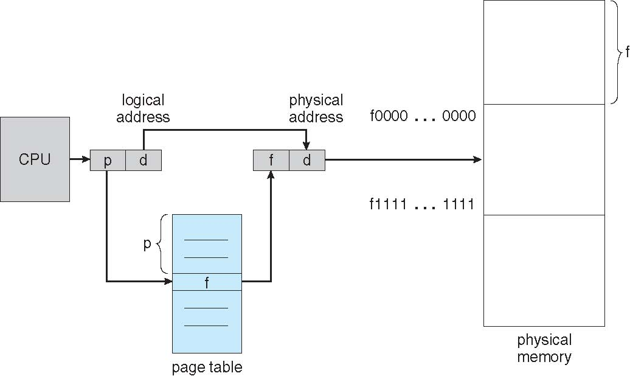
Paging Hardware

Slide 33
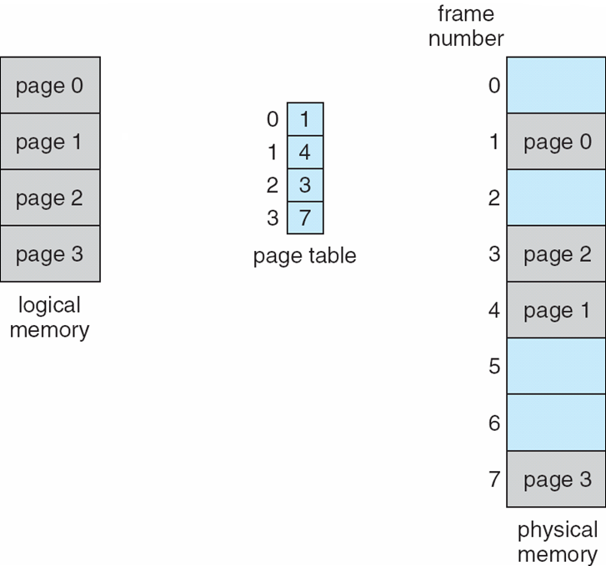
Paging Model of Logical and Physical Memory

Slide 34
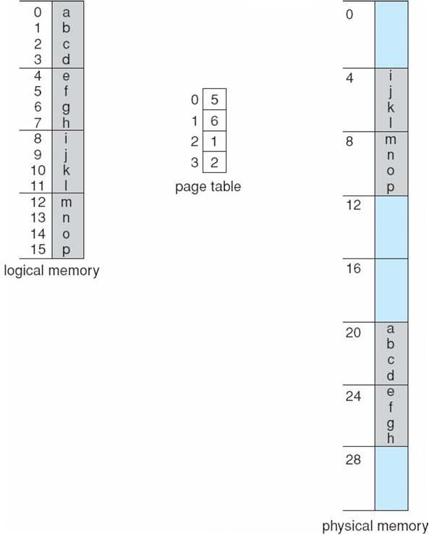
Paging Example
n=2 and m=4 32-byte memory and 4-byte pages

Slide 35
Paging (Cont.)
Calculating internal fragmentation
Page size = 2,048 bytes
Process size = 72,766 bytes
35 pages + 1,086 bytes
Internal fragmentation of 2,048 - 1,086 = 962 bytes
Worst case fragmentation = 1 frame – 1 byte
On average fragmentation = 1 / 2 frame size
So small frame sizes desirable?
But each page table entry takes memory to track
Page sizes growing over time
Solaris supports two page sizes – 8 KB and 4 MB
Process view and physical memory now very different
By implementation process can only access its own memory

Slide 36
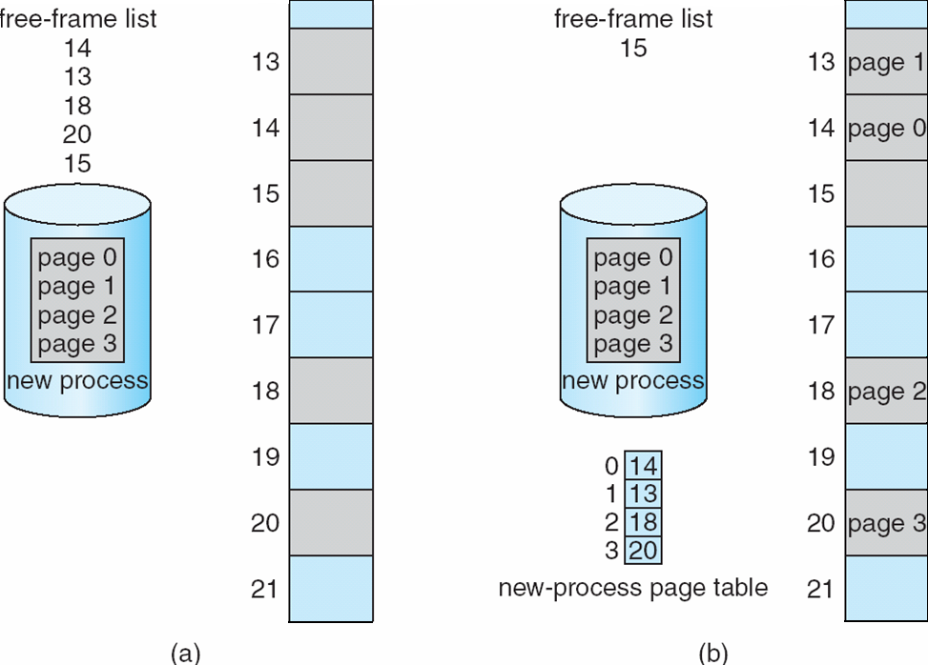
Free Frames
Before allocation
After allocation

Slide 37
Implementation of Page Table
Page table is kept in main memory
Page-table base register (PTBR) points to the page table
Page-table length register (PTLR) indicates size of the page table
In this scheme every data/instruction access requires two memory accesses
One for the page table and one for the data / instruction
The two memory access problem can be solved by the use of a special fast-lookup hardware cache called associative memory or translation look-aside buffers (TLBs)

Slide 38
Implementation of Page Table (Cont.)
Some TLBs store address-space identifiers (ASIDs) in each TLB entry – uniquely identifies each process to provide address-space protection for that process
Otherwise need to flush at every context switch
TLBs typically small (64 to 1,024 entries)
On a TLB miss, value is loaded into the TLB for faster access next time
Replacement policies must be considered
Some entries can be wired down for permanent fast access

Slide 39
Associative Memory
Associative memory – parallel search
Address translation (p, d)
If p is in associative register, get frame # out
Otherwise get frame # from page table in memory

Slide 40
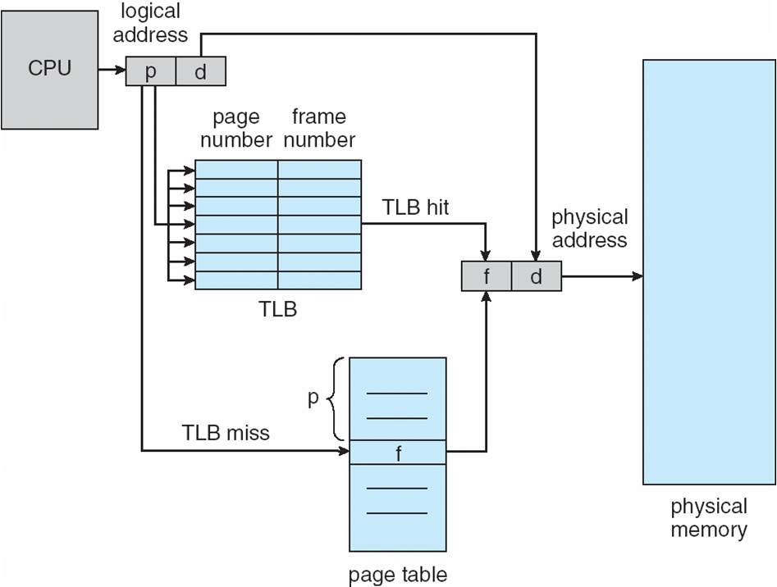
Paging Hardware With TLB

Slide 41
Effective Access Time
Associative Lookup = ε time unit
Can be < 10% of memory access time
Hit ratio = α
Hit ratio – percentage of times that a page number is found in the associative registers; ratio related to number of associative registers
Consider α = 80%, ε = 20ns for TLB search, 100ns for memory access
Effective Access Time (EAT)
[ (H)(TLB access time + mem access time) + (1-H)(TLB access + PT access + mem access)]
EAT = (1 + ε) α + (2 + ε)(1 – α)
= 2 + ε – α
Consider α = 80%, ε = 20ns for TLB search, 100ns for memory access
Effective Access Time = (.8)(120) + (.2)(220) = 140 ns
Consider more realistic hit ratio -> α = 99%, ε = 20ns for TLB search, 100ns for memory access
EAT = 0.99 x 100 + 0.01 x 200 = 101ns

Slide 42
Memory Protection
Memory protection implemented by associating protection bit with each frame to indicate if read-only or read-write access is allowed
Can also add more bits to indicate page execute-only, and so on
Valid-invalid bit attached to each entry in the page table:
“valid” indicates that the associated page is in the process’ logical address space, and is thus a legal page
“invalid” indicates that the page is not in the process’ logical address space
Or use page-table length register (PTLR)
Any violations result in a trap to the kernel

Slide 43
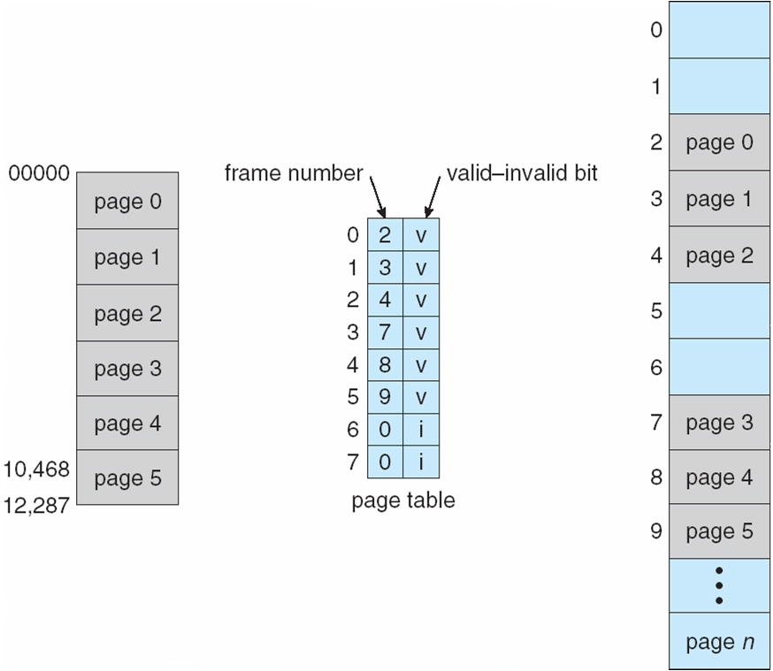
Valid (v) or Invalid (i) Bit In A Page Table

Slide 44
Shared Pages
Shared code
One copy of read-only (reentrant) code shared among processes (i.e., text editors, compilers, window systems)
Similar to multiple threads sharing the same process space
Also useful for interprocess communication if sharing of read-write pages is allowed
Private code and data
Each process keeps a separate copy of the code and data
The pages for the private code and data can appear anywhere in the logical address space

Slide 45
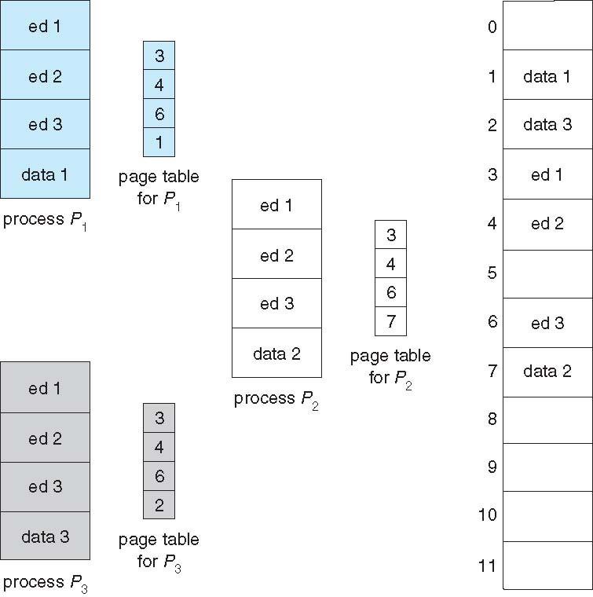
Shared Pages Example

Slide 46
Structure of the Page Table
Memory structures for paging can get huge using straight-forward methods
Consider a 32-bit logical address space as on modern computers
Page size of 4 KB (2¹²)
Page table would have 1 million entries (2³² / 2¹²)
If each entry is 4 bytes -> 4 MB of physical address space / memory for page table alone
That amount of memory used to cost a lot
Don’t want to allocate that contiguously in main memory
Hierarchical Paging
Hashed Page Tables
Inverted Page Tables

Slide 47
Hierarchical Page Tables
Break up the logical address space into multiple page tables
A simple technique is a two-level page table
We then page the page table

Slide 48
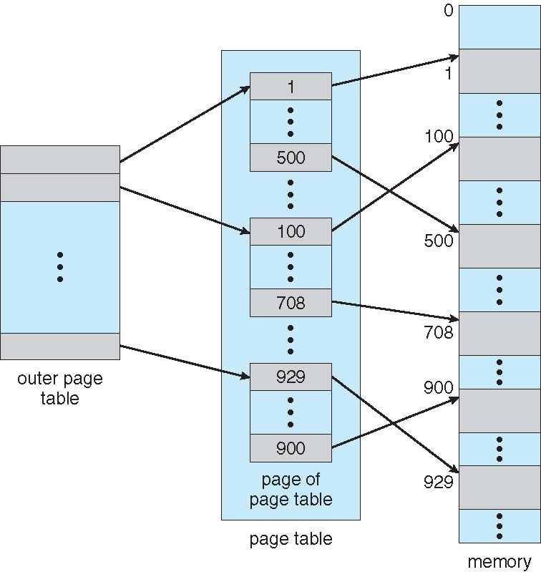
Two-Level Page-Table Scheme

Slide 49
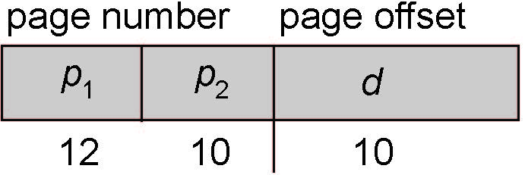
Two-Level Paging Example
A logical address (on 32-bit machine with 1K page size) is divided into:
a page number consisting of 22 bits
a page offset consisting of 10 bits
Since the page table is paged, the page number is further divided into:
a 12-bit page number
a 10-bit page offset
Thus, a logical address is as follows:
where p₁ is an index into the outer page table, and p₂ is the displacement within the page of the inner page table
Known as forward-mapped page table

Slide 50
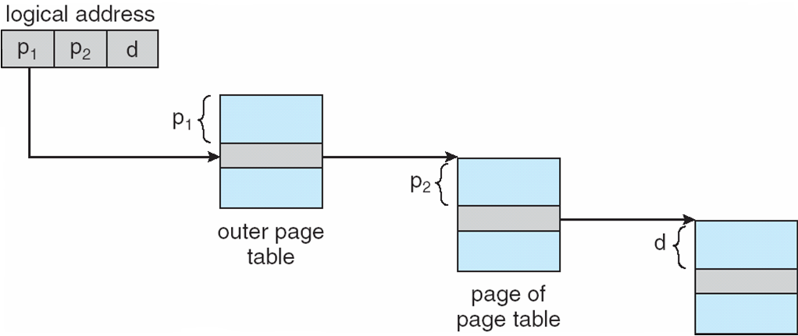
Address-Translation Scheme

Slide 51
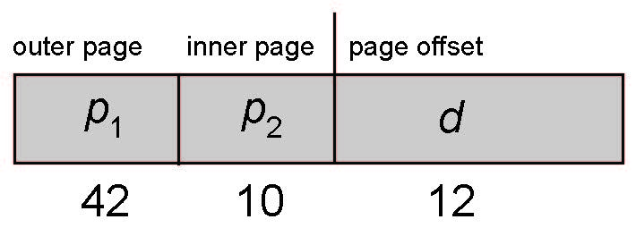
64-bit Logical Address Space
Even two-level paging scheme not sufficient
If page size is 4 KB (2¹²)
Then page table has 2⁵² entries
If two level scheme, inner page tables could be 2¹⁰ 4-byte entries
Address would look like
Outer page table has 2⁴² entries or 2⁴⁴ bytes
One solution is to add a 2nd outer page table
But in the following example the 2nd outer page table is still 2³⁴ bytes in size
And possibly 4 memory access to get to one physical memory location

Slide 52
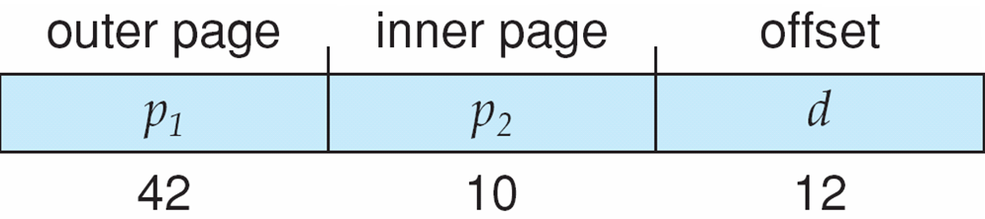
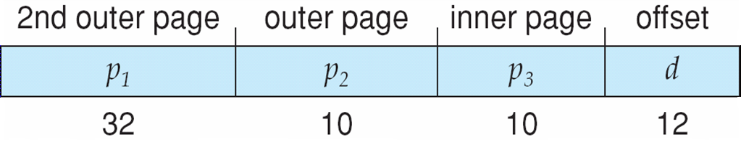
Three-level Paging Scheme

Slide 53
Hashed Page Tables
Common in address spaces > 32 bits
The virtual page number is hashed into a page table
This page table contains a chain of elements hashing to the same location
Each element contains (1) the virtual page number (2) the value of the mapped page frame (3) a pointer to the next element
Virtual page numbers are compared in this chain searching for a match
If a match is found, the corresponding physical frame is extracted
Variation for 64-bit addresses is clustered page tables
Similar to hashed but each entry refers to several pages (such as 16) rather than 1
Especially useful for sparse address spaces (where memory references are non-contiguous and scattered)

Slide 54
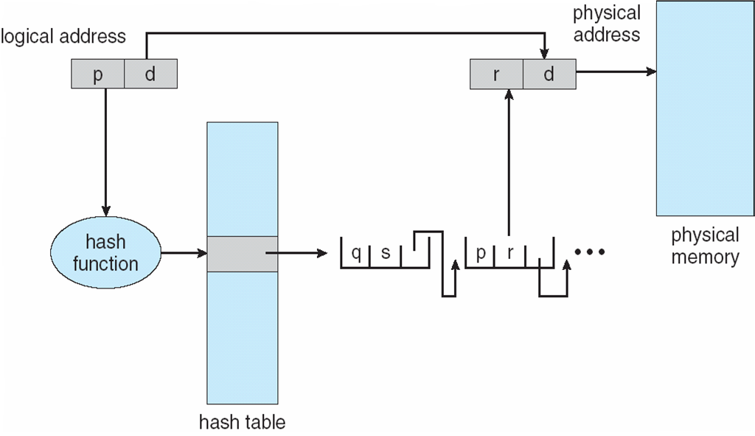
Hashed Page Table

Slide 55
Inverted Page Table
Rather than each process having a page table and keeping track of all possible logical pages, track all physical pages
One entry for each real page of memory
Entry consists of the virtual address of the page stored in that real memory location, with information about the process that owns that page
Decreases memory needed to store each page table, but increases time needed to search the table when a page reference occurs
Use hash table to limit the search to one — or at most a few — page-table entries
TLB can accelerate access
But how to implement shared memory?
One mapping of a virtual address to the shared physical address

Slide 56
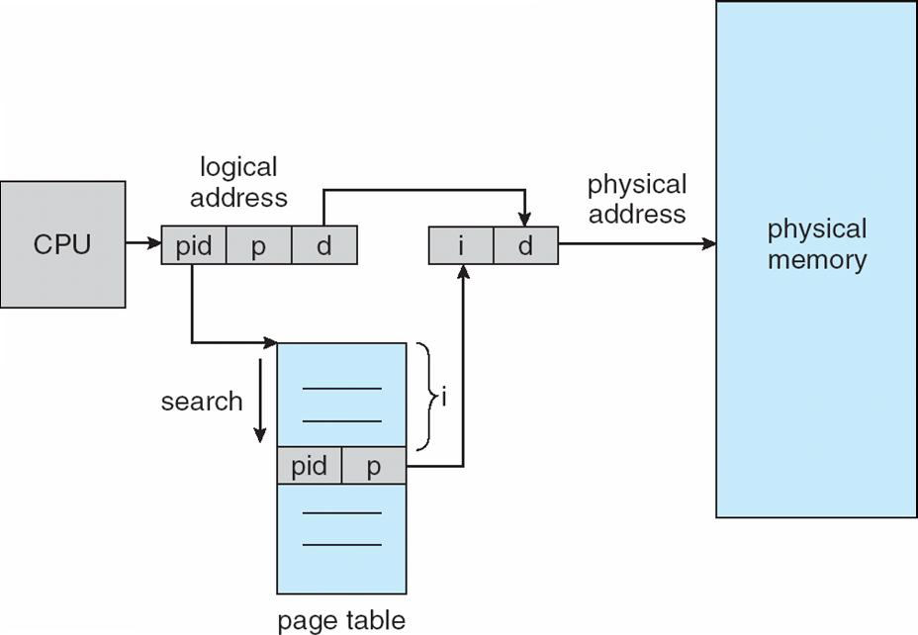
Inverted Page Table Architecture

Slide 57
Virtual Memory Background
Code needs to be in memory to execute, but entire program rarely used
Error code, unusual routines, large data structures
Entire program code not needed at same time
Consider ability to execute partially-loaded program
Program no longer constrained by limits of physical memory
Each program takes less memory while running -> more programs run at the same time
Increased CPU utilization and throughput with no increase in response time or turnaround time
Less I/O needed to load or swap programs into memory -> each user program runs faster

Slide 58
Background (Cont.)
Virtual memory – separation of user logical memory from physical memory
Only part of the program needs to be in memory for execution
Logical address space can therefore be much larger than physical address space
Allows address spaces to be shared by several processes
Allows for more efficient process creation
More programs running concurrently
Less I/O needed to load or swap processes

Slide 59
Background (Cont.)
Virtual address space – logical view of how process is stored in memory
Usually start at address 0, contiguous addresses until end of space
Meanwhile, physical memory organized in page frames
MMU must map logical to physical
Virtual memory can be implemented via:
Demand paging
Demand segmentation

Slide 60
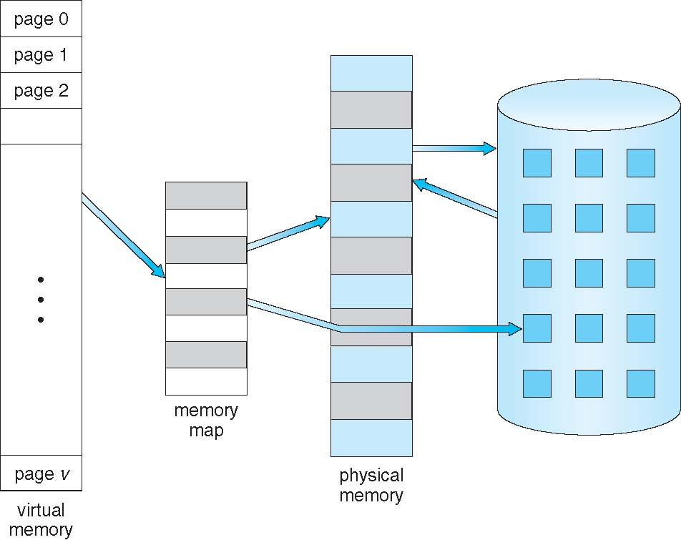
Virtual Memory That is Larger Than Physical Memory

Slide 61
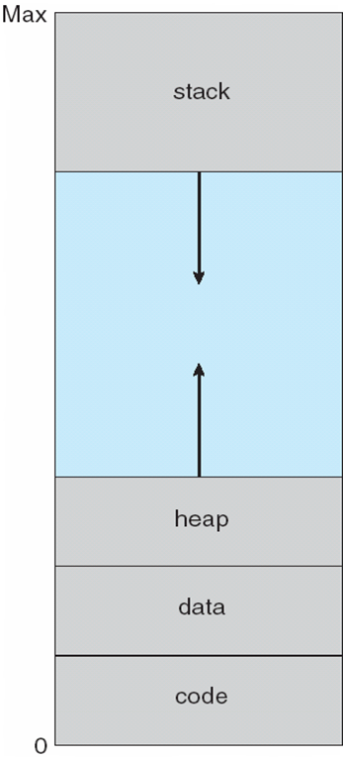
Virtual-address Space
Usually design logical address space for stack to start at Max logical address and grow “down” while heap grows “up”
Maximizes address space use
Unused address space between the two is hole
No physical memory needed until heap or stack grows to a given new page
Enables sparse address spaces with holes left for growth, dynamically linked libraries, etc
System libraries shared via mapping into virtual address space
Shared memory by mapping pages read-write into virtual address space
Pages can be shared during fork(), speeding process creation

Slide 62
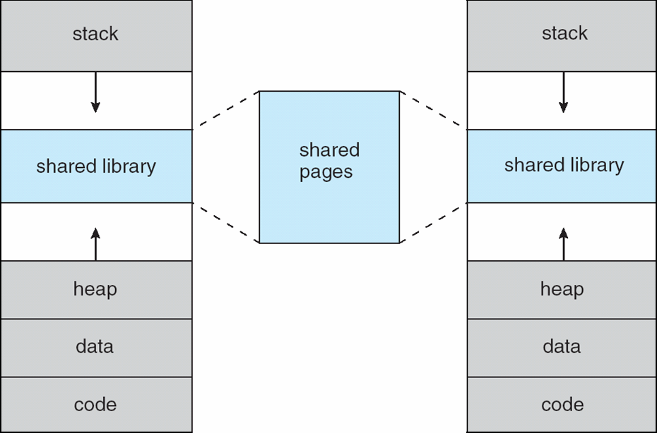
Shared Library Using Virtual Memory

Slide 63
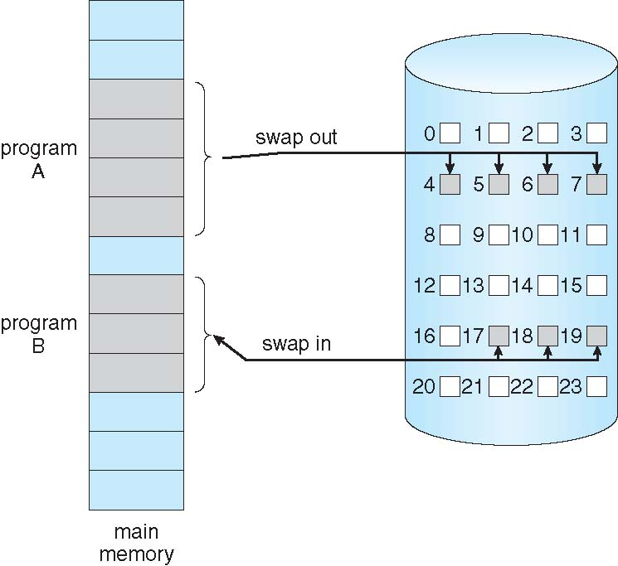
Demand Paging
Could bring entire process into memory at load time
Or bring a page into memory only when it is needed
Less I/O needed, no unnecessary I/O
Less memory needed
Faster response
More users
Similar to paging system with swapping
Page is needed ⇒ reference to it
invalid reference ⇒ abort
not-in-memory ⇒ bring to memory
Lazy swapper – never swaps a page into memory unless page will be needed
Swapper that deals with pages is a pager

Slide 64
Basic Concepts
With swapping, pager guesses which pages will be used before swapping out again
Instead, pager brings in only those pages into memory
How to determine that set of pages?
Need new MMU functionality to implement demand paging
If pages needed are already memory resident
No difference from non demand-paging
If page needed and not memory resident
Need to detect and load the page into memory from storage
Without changing program behavior
Without programmer needing to change code

Slide 65
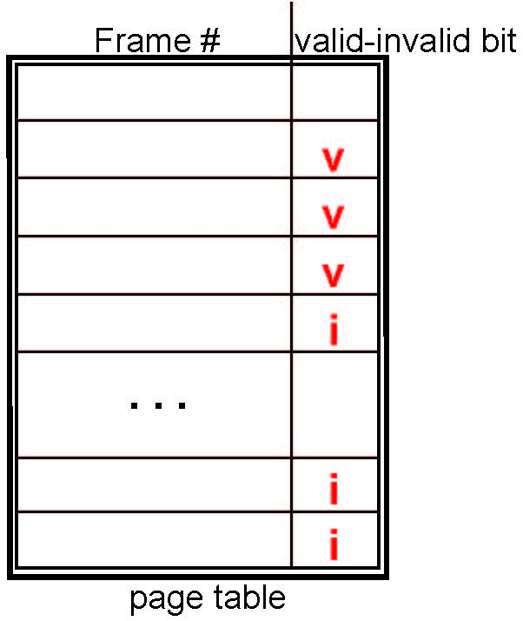
Valid-Invalid Bit
With each page table entry a valid–invalid bit is associated (v ⇒ in-memory – memory resident, i ⇒ not-in-memory)
Initially valid–invalid bit is set to i on all entries
During MMU address translation, if valid–invalid bit in page table entry is i ⇒ page fault

Slide 66
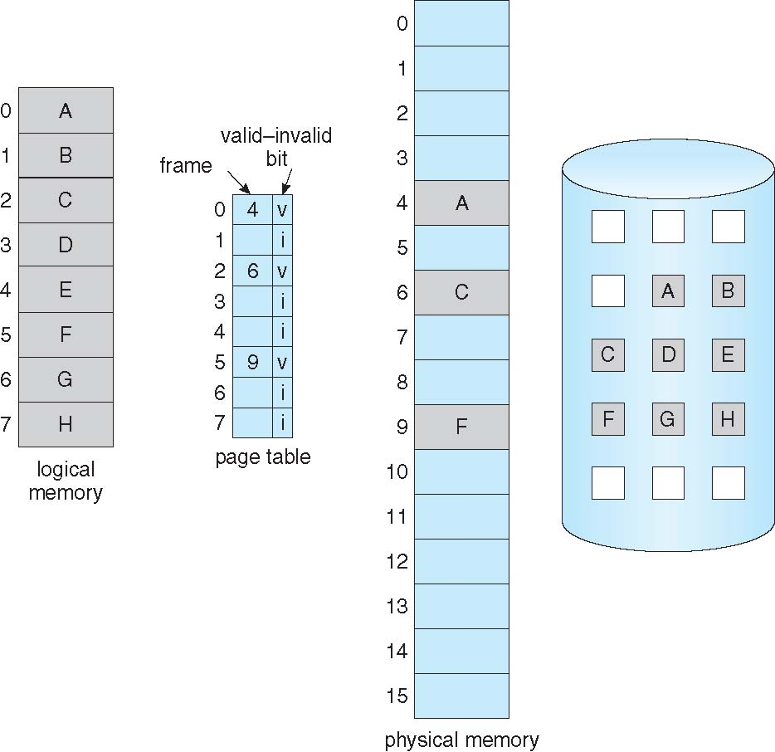
Page Table When Some Pages Are Not in Main Memory

Slide 67
Page Fault
If there is a reference to a page, first reference to that page will trap to operating system:
page fault
Operating system looks at another table to decide:
Invalid reference ⇒ abort
Just not in memory
Find free frame
Swap page into frame via scheduled disk operation
Reset tables to indicate page now in memory Set validation bit = v
Restart the instruction that caused the page fault

Slide 68
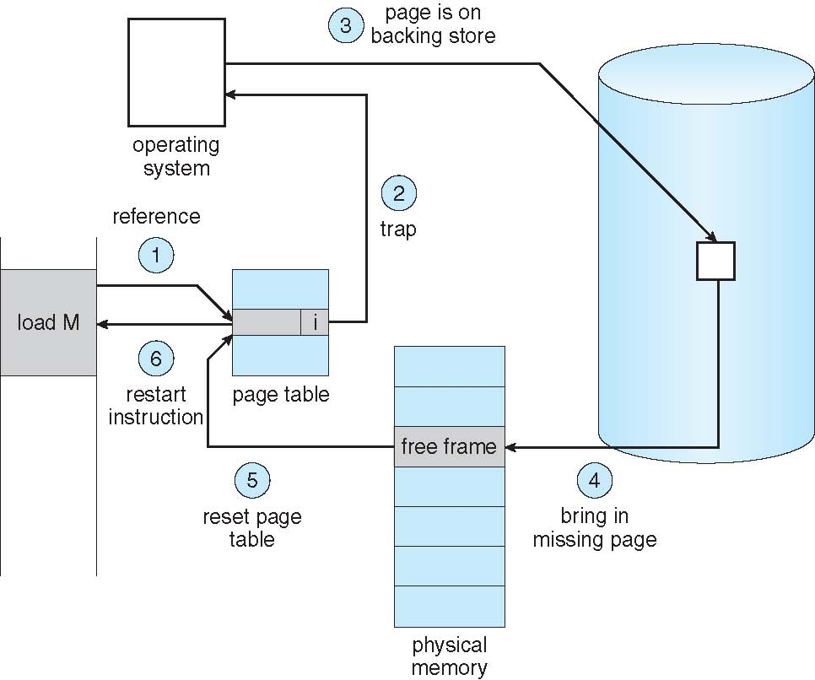
Steps in Handling a Page Fault

Slide 69
Aspects of Demand Paging
Extreme case – start process with no pages in memory
OS sets instruction pointer to first instruction of process, non-memory-resident -> page fault
And for every other process pages on first access
Pure demand paging
Actually, a given instruction could access multiple pages -> multiple page faults
Consider fetch and decode of instruction which adds 2 numbers from memory and stores result back to memory
Pain decreased because of locality of reference
Hardware support needed for demand paging
Page table with valid / invalid bit
Secondary memory (swap device with swap space)
Instruction restart

Slide 70
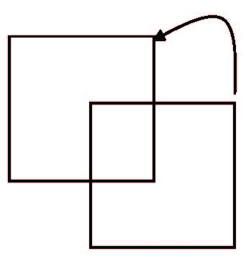
Instruction Restart
Consider an instruction that could access several different locations
block move
auto increment/decrement location
Restart the whole operation?
What if source and destination overlap?

Slide 71
Performance of Demand Paging
Stages in Demand Paging (worse case)
Trap to the operating system
Save the user registers and process state
Determine that the interrupt was a page fault
Check that the page reference was legal and determine the location of the page on the disk
Issue a read from the disk to a free frame:
Wait in a queue for this device until the read request is serviced
Wait for the device seek and/or latency time
Begin the transfer of the page to a free frame
While waiting, allocate the CPU to some other user
Receive an interrupt from the disk I/O subsystem (I/O completed)
Save the registers and process state for the other user
Determine that the interrupt was from the disk
Correct the page table and other tables to show page is now in memory
Wait for the CPU to be allocated to this process again
Restore the user registers, process state, and new page table, and then resume the interrupted instruction

Slide 72
Performance of Demand Paging (Cont.)
Three major activities
Service the interrupt – careful coding means just several hundred instructions needed
Read the page – lots of time
Restart the process – again just a small amount of time
Page Fault Rate 0 ≤ p ≤ 1
if p = 0 no page faults
if p = 1, every reference is a fault
Effective Access Time (EAT)
EAT = (1 – p) x memory access
+ p (page fault overhead
+ swap page out
+ swap page in )

Slide 73
Demand Paging Example
Memory access time = 200 nanoseconds
Average page-fault service time = 8 milliseconds
EAT = (1 – p) x 200 + p (8 milliseconds)
= (1 – p x 200 + p x 8,000,000
= 200 + p x 7,999,800
If one access out of 1,000 causes a page fault, then
EAT = 8.2 microseconds.
If want performance degradation < 10 percent
220 > 200 + 7,999,800 x p 20 > 7,999,800 x p
p < .0000025
< one page fault in every 400,000 memory accesses

Slide 74
Demand Paging Optimizations
Swap space I/O faster than file system I/O even if on the same device
Swap allocated in larger chunks, less management needed than file system
Copy entire process image to swap space at process load time
Then page in and out of swap space
Used in older BSD Unix
Demand page in from program binary on disk, but discard rather than paging out when freeing frame
Used in Solaris and current BSD
Still need to write to swap space
Pages not associated with a file (like stack and heap) – anonymous memory
Pages modified in memory but not yet written back to the file system

Slide 75
Copy-on-Write
Copy-on-Write (COW) allows both parent and child processes to initially share the same pages in memory
If either process modifies a shared page, only then is the page copied
COW allows more efficient process creation as only modified pages are copied
In general, free pages are allocated from a pool of zero-fill-on-demand pages
Pool should always have free frames for fast demand page execution
Don’t want to have to free a frame as well as other processing on page fault
Why zero-out a page before allocating it?

Slide 76
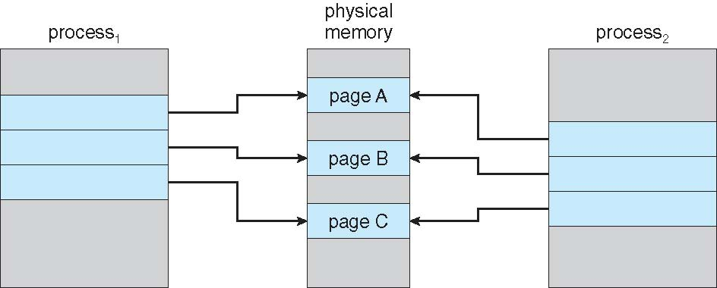
Before Process 1 Modifies Page C

Slide 77
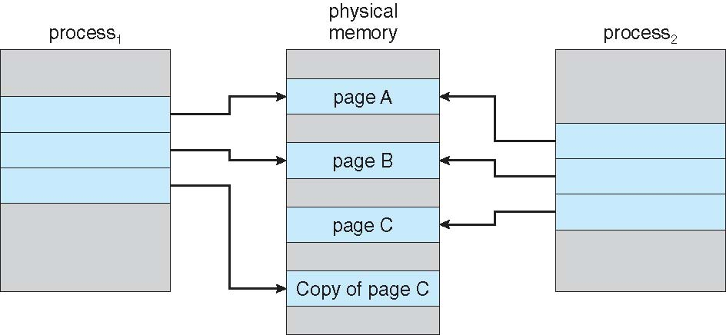
After Process 1 Modifies Page C

Slide 78
What Happens if There is no Free Frame?
Used up by process pages
Also in demand from the kernel, I/O buffers, etc
How much to allocate to each?
Page replacement – find some page in memory, but not really in use, page it out
Algorithm – terminate? swap out? replace the page?
Performance – want an algorithm which will result in minimum number of page faults
Same page may be brought into memory several times

Slide 79
Page Replacement
Prevent over-allocation of memory by modifying page-fault service routine to include page replacement
Use modify (dirty) bit to reduce overhead of page transfers – only modified pages are written to disk
Page replacement completes separation between logical memory and physical memory – large virtual memory can be provided on a smaller physical memory

Slide 80
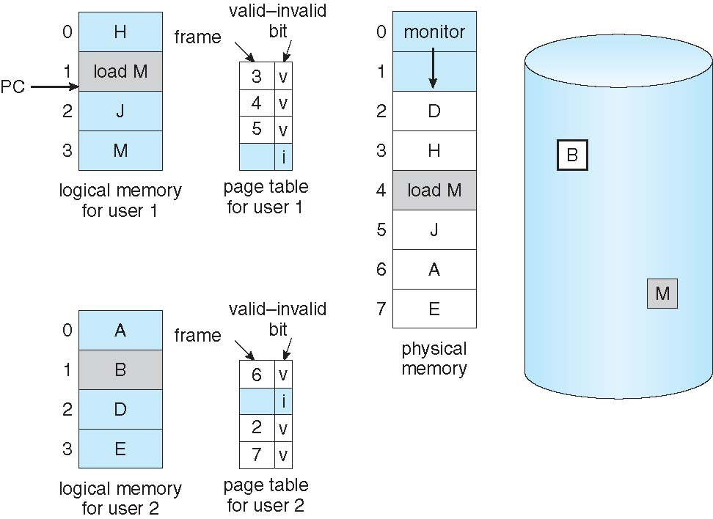
Need For Page Replacement

Slide 81
Basic Page Replacement
Find the location of the desired page on disk
Find a free frame: - If there is a free frame, use it - If there is no free frame, use a page replacement algorithm to select a victim frame - Write victim frame to disk if dirty
Bring the desired page into the (newly) free frame; update the page and frame tables
Continue the process by restarting the instruction that caused the trap
Note now potentially 2 page transfers for page fault – increasing EAT

Slide 82
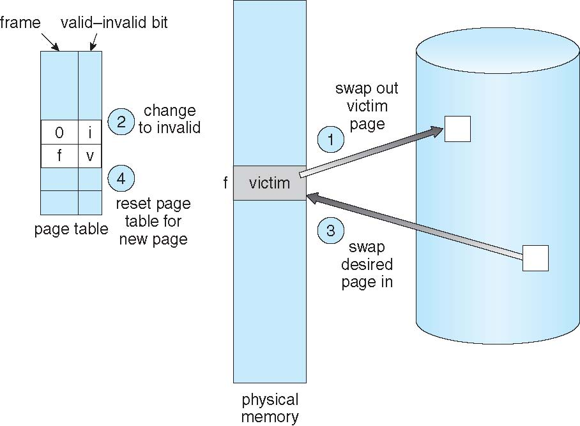
Page Replacement

Slide 83
Page and Frame Replacement Algorithms
Frame-allocation algorithm determines
How many frames to give each process
Which frames to replace
Page-replacement algorithm
Want lowest page-fault rate on both first access and re-access
Evaluate algorithm by running it on a particular string of memory references (reference string) and computing the number of page faults on that string
String is just page numbers, not full addresses
Repeated access to the same page does not cause a page fault
Results depend on number of frames available
In all our examples, the reference string of referenced page numbers is
7,0,1,2,0,3,0,4,2,3,0,3,0,3,2,1,2,0,1,7,0,1

Slide 84
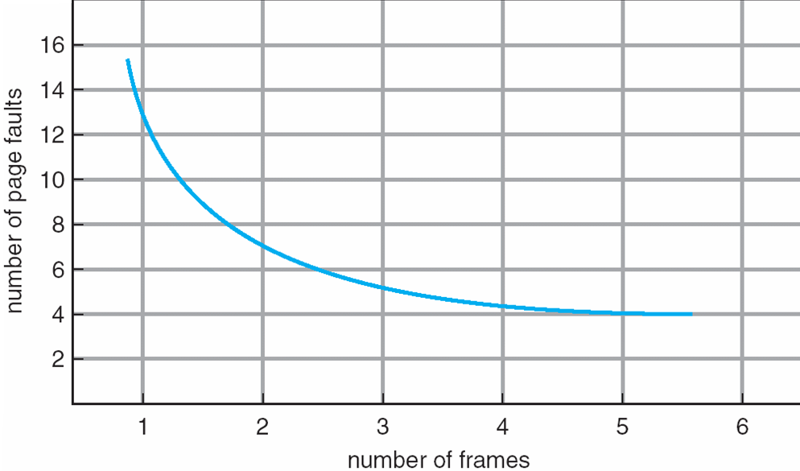
Graph of Page Faults Versus The Number of Frames

Slide 85
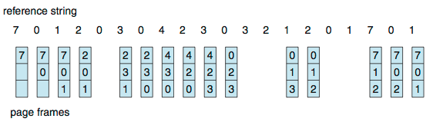
First-In-First-Out (FIFO) Algorithm
Reference string: 7,0,1,2,0,3,0,4,2,3,0,3,0,3,2,1,2,0,1,7,0,1
3 frames (3 pages can be in memory at a time per process)
Can vary by reference string: consider 1,2,3,4,1,2,5,1,2,3,4,5
Adding more frames can cause more page faults!
Belady’s Anomaly
How to track ages of pages?
Just use a FIFO queue
15 page faults

Slide 86
FIFO Illustrating Belady’s Anomaly

Slide 87
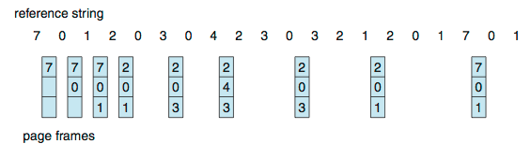
Optimal Algorithm
Replace page that will not be used for longest period of time
9 is optimal for the example
How do you know this?
Can’t read the future
Used for measuring how well your algorithm performs

Slide 88
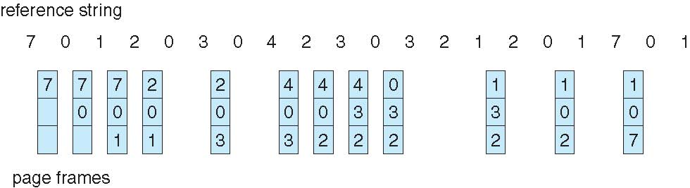
Least Recently Used (LRU) Algorithm
Use past knowledge rather than future
Replace page that has not been used in the most amount of time
Associate time of last use with each page
12 faults – better than FIFO but worse than OPT
Generally good algorithm and frequently used
But how to implement?

Slide 89
LRU Algorithm (Cont.)
Counter implementation
Every page entry has a counter; every time page is referenced through this entry, copy the clock into the counter
When a page needs to be changed, look at the counters to find smallest value
Search through table needed
Stack implementation
Keep a stack of page numbers in a double link form:
Page referenced:
move it to the top
requires 6 pointers to be changed
But each update more expensive
No search for replacement
LRU and OPT are cases of stack algorithms that don’t have Belady’s Anomaly

Slide 90
Use Of A Stack to Record Most Recent Page References

Slide 91
LRU Approximation Algorithms
LRU needs special hardware and still slow
Reference bit
With each page associate a bit, initially = 0
When page is referenced bit set to 1
Replace any with reference bit = 0 (if one exists)
We do not know the order, however
Second-chance algorithm
Generally FIFO, plus hardware-provided reference bit
Clock replacement
If page to be replaced has
Reference bit = 0 -> replace it
reference bit = 1 then:
set reference bit 0, leave page in memory
replace next page, subject to same rules

Slide 92
Second-Chance (clock) Page-Replacement Algorithm

Slide 93
Enhanced Second-Chance Algorithm
Improve algorithm by using reference bit and modify bit (if available) in concert
Take ordered pair (reference, modify)
(0, 0) neither recently used not modified – best page to replace
(0, 1) not recently used but modified – not quite as good, must write out before replacement
(1, 0) recently used but clean – probably will be used again soon
(1, 1) recently used and modified – probably will be used again soon and need to write out before replacement
When page replacement called for, use the clock scheme but use the four classes replace page in lowest non-empty class
Might need to search circular queue several times

Slide 94
Counting Algorithms
Keep a counter of the number of references that have been made to each page
Not common
Lease Frequently Used (LFU) Algorithm: replaces page with smallest count
Most Frequently Used (MFU) Algorithm: based on the argument that the page with the smallest count was probably just brought in and has yet to be used

Slide 95
Page-Buffering Algorithms
Keep a pool of free frames, always
Then frame available when needed, not found at fault time
Read page into free frame and select victim to evict and add to free pool
When convenient, evict victim
Possibly, keep list of modified pages
When backing store otherwise idle, write pages there and set to non-dirty
Possibly, keep free frame contents intact and note what is in them
If referenced again before reused, no need to load contents again from disk
Generally useful to reduce penalty if wrong victim frame selected

Slide 96
Thrashing
If a process does not have “enough” pages, the page-fault rate is very high
Page fault to get page
Replace existing frame
But quickly need replaced frame back
This leads to:
Low CPU utilization
Operating system thinking that it needs to increase the degree of multiprogramming
Another process added to the system
Thrashing ≡ a process is busy swapping pages in and out

Slide 97
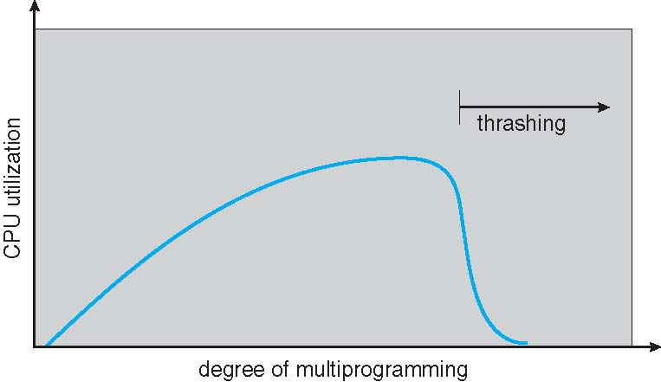
Thrashing (Cont.)

Slide 98
Demand Paging and Thrashing
Why does demand paging work? Locality model
Process migrates from one locality to another
Localities may overlap
Why does thrashing occur? Σ size of locality > total memory size
Limit effects by using local or priority page replacement

Slide 99
Locality In A Memory-Reference Pattern

Slide 100
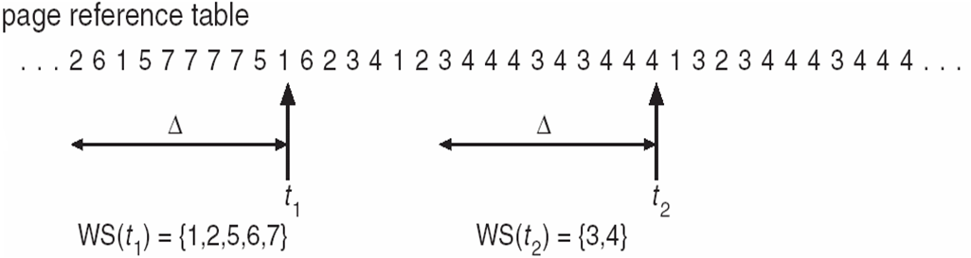
Working-Set Model
Δ ≡ working-set window ≡ a fixed number of page references Example: 10,000 instructions
WSS_{i} (working set of Process P_{i}) = total number of pages referenced in the most recent Δ (varies in time)
if Δ too small will not encompass entire locality
if Δ too large will encompass several localities
if Δ = ∞ ⇒ will encompass entire program
D = Σ WSS_{i} ≡ total demand frames
Approximation of locality
if D > m (total number of available frames) ⇒ Thrashing
Policy if D > m, then suspend or swap out one of the processes

Slide 101
Keeping Track of the Working Set
Approximate with interval timer + a reference bit
Example: Δ = 10,000
Timer interrupts after every 5000 time units
Keep in memory 2 bits for each page
Whenever a timer interrupts copy and sets the values of all reference bits to 0
If one of the bits in memory = 1 ⇒ page in working set
Why is this not completely accurate?
We cannot tell where, within an interval of 5,000, a reference occurred
We can reduce the uncertainty by increasing the number of history bits and the frequency of interrupts
Improvement = 10 bits and interrupt every 1000 time units
However, the cost to service these more frequent interrupts will be correspondingly higher

Slide 102
Page-Fault Frequency
More direct approach than WSS
Establish “acceptable” page-fault frequency (PFF) rate and use local replacement policy
If actual rate too low, process loses frame
If actual rate too high, process gains frame

Slide 103
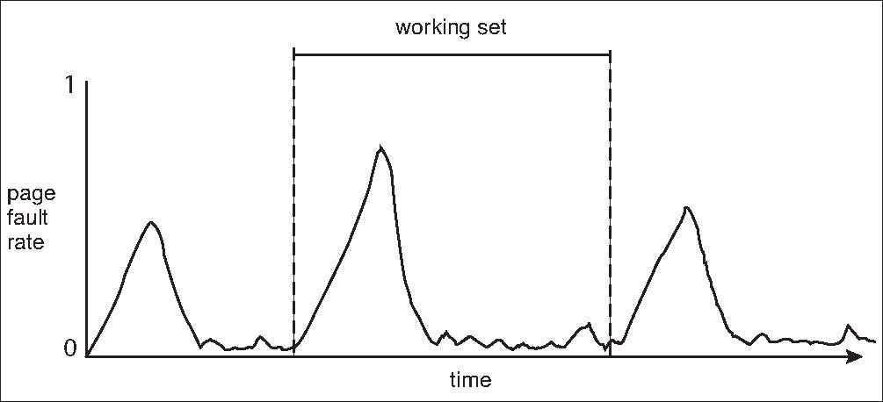
Working Sets and Page Fault Rates
Direct relationship between working set of a process and its page-fault rate
Working set changes over time
Peaks and valleys over time

Slide 104
Memory-Mapped Files
Memory-mapped file I/O allows file I/O to be treated as routine memory access by mapping a disk block to a page in memory
A file is initially read using demand paging
A page-sized portion of the file is read from the file system into a physical page
Subsequent reads/writes to/from the file are treated as ordinary memory accesses
Simplifies and speeds file access by driving file I/O through memory rather than read()and write() system calls
Also allows several processes to map the same file allowing the pages in memory to be shared
But when does written data make it to disk?
Periodically and / or at file close() time
For example, when the pager scans for dirty pages

Slide 105
Memory-Mapped File Technique for all I/O
Some OSes uses memory mapped files for standard I/O
Process can explicitly request memory mapping a file via mmap() system call
Now file mapped into process address space
For standard I/O (open(), read(), write(), close()), mmap anyway
But map file into kernel address space
Process still does read() and write()
Copies data to and from kernel space and user space
Uses efficient memory management subsystem
Avoids needing separate subsystem
COW can be used for read/write non-shared pages
Memory mapped files can be used for shared memory (although again via separate system calls)

Slide 106
Memory Mapped Files

Slide 107
Shared Memory via Memory-Mapped I/O

Slide 108
Allocating Kernel Memory
Treated differently from user memory
Often allocated from a free-memory pool
Kernel requests memory for structures of varying sizes
Some kernel memory needs to be contiguous
I.e. for device I/O

Slide 109
Other Considerations -- Prepaging
Prepaging
To reduce the large number of page faults that occurs at process startup
Prepage all or some of the pages a process will need, before they are referenced
But if prepaged pages are unused, I/O and memory was wasted
Assume s pages are prepaged and α of the pages is used
Is cost of s * α save pages faults > or < than the cost of prepaging s * (1- α) unnecessary pages?
α near zero ⇒ prepaging loses

Slide 110
Source and Acknowledgement
Operating System Concepts, Ninth Edition, A. Silberschatz, Peter Baer Galvin and G. Gagne.
https://www.os-book.com/OS9/slide-dir/index.html

